Slide 1
BigMart Sales Prediction
Sales Prediction using Machine Learning

Slide 2
Objective:
“To find out what role certain properties of an item play and how they affect their sales by understanding Big Mart sales.”
In order to help Big Mart, achieve this goal, a predictive model can be built to find out the sale of every item for every store. Also, the key factors that can increase their sales and what changes could be made to the product or store’s characteristics.

Slide 3
Benefits:
Detection the features heavily responsible for item sales from particular outlet.
Gives better insight of customers interest for the item.
Helps in easy flow for managing resources.
Manual inspection of what action needed to hike the sale.

Slide 4
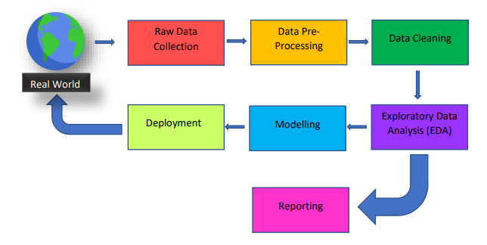
Architecture

Slide 5
Data Description
Item_Identifier: Unique product ID
Item_Weight: Weight of the product
Item_Fat_Content: Whether the product is low fat or not
Item_Visibility: The % of the total display area of all products in a store allocated to the particular product
Item_Type: The category to which the product belongs
Item_MRP: Maximum Retail Price (list price) of the product
Outlet_Identifier: Unique store ID
Outlet_Establishment_Year: The year in which the store was established
Outlet_Size: The size of the store in terms of ground area covered
Outlet_Location_Type: The type of city in which the store is located
Outlet_Type: Whether the outlet is just a grocery store or some sort of supermarket
Item_Outlet_Sales: Sales of the product in the particular store. This is the outcome variable to be predicted.

Slide 6
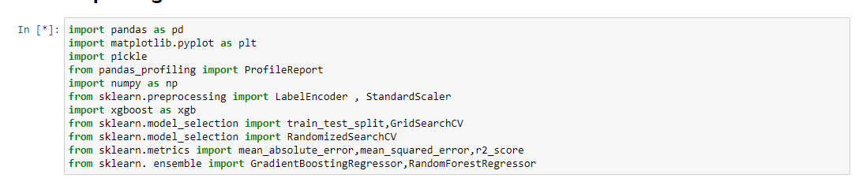
Importing Libraries

Slide 7
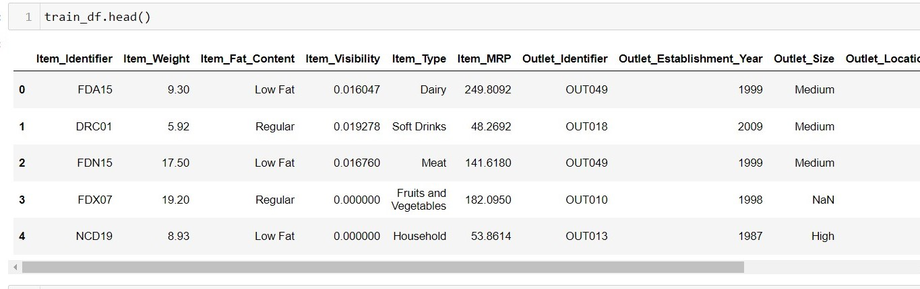
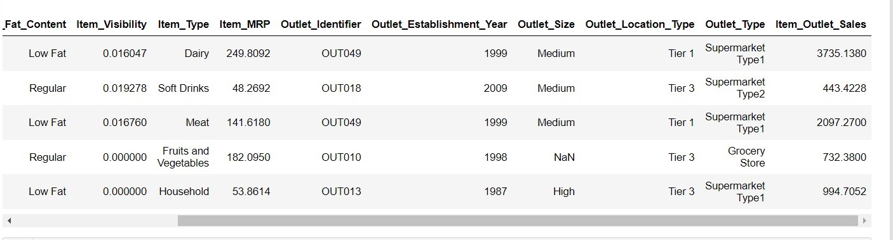
Dataset

Slide 8
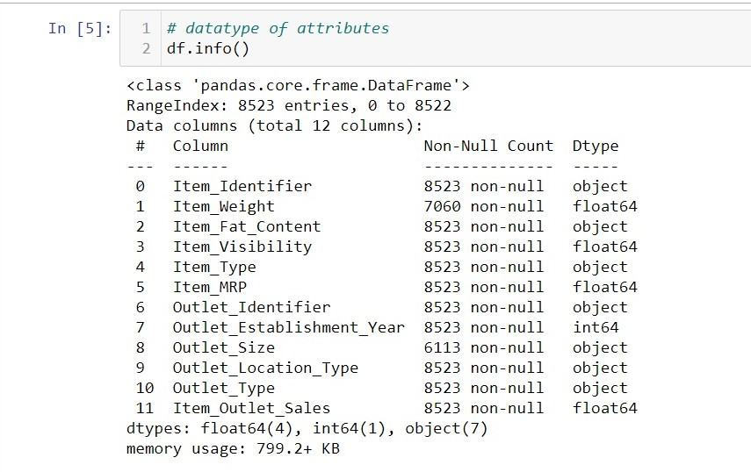
Dataset Info. The data set consists of various data types from integer to float to object as shown in Fig.

Slide 9
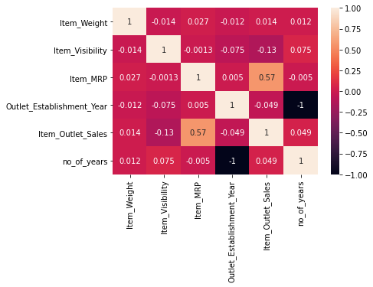
Correlation
Correlation is used to understand the relation between a target variable and predictors. In this work, Item-Sales is the target variable and its correlation with other variables is observed.

Slide 10
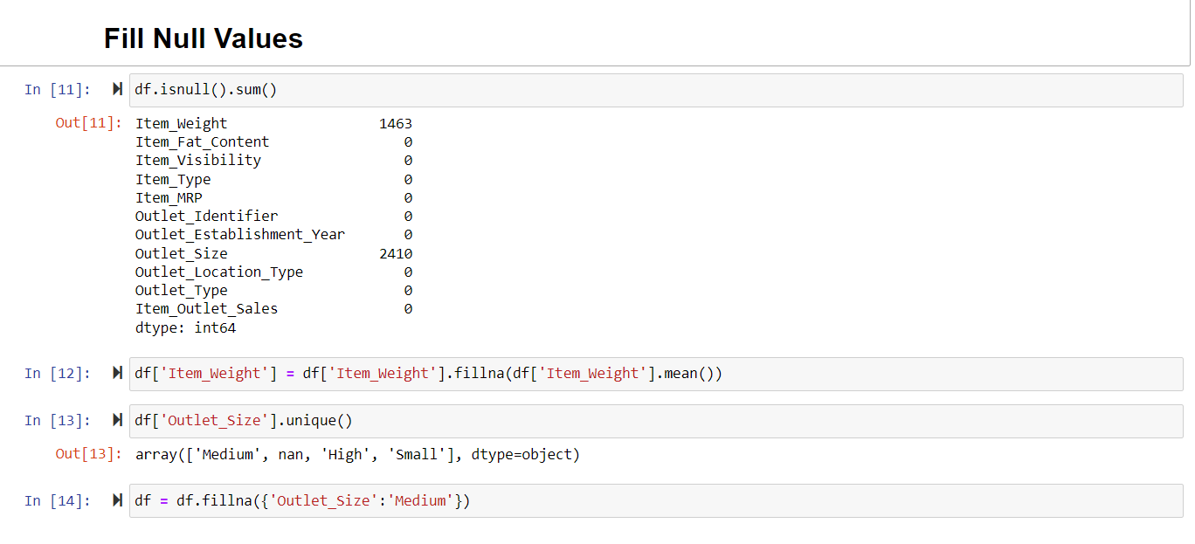
Handling Null Values

Slide 11
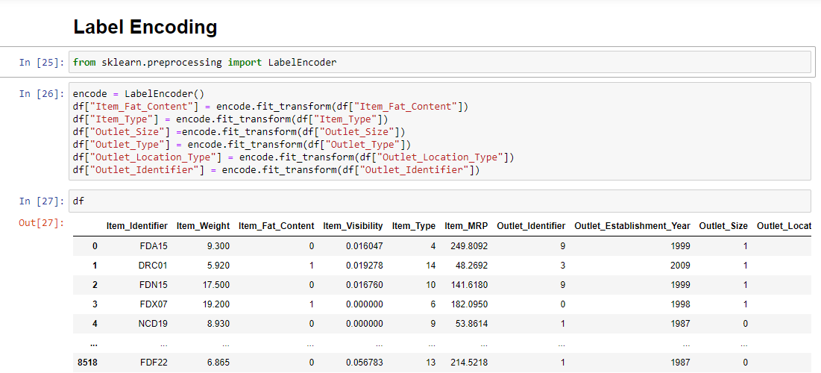
Label Encoding

Slide 12
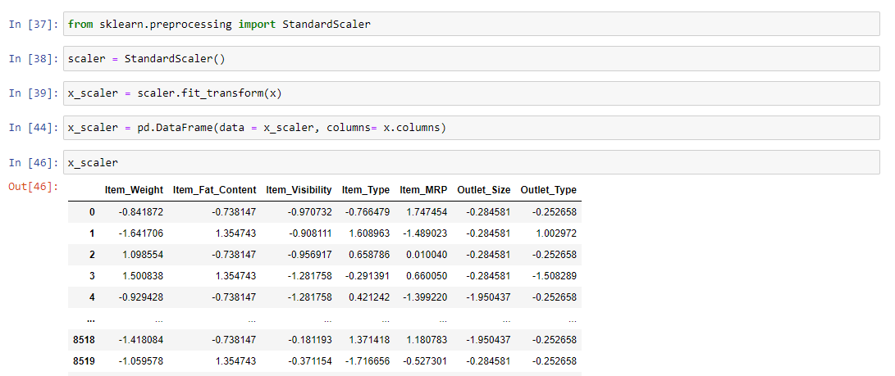
Standard Scaling

Slide 13
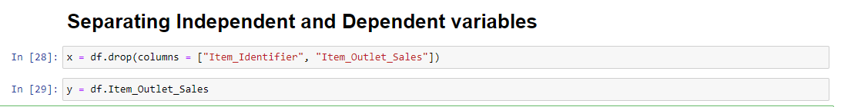
Separating Dependent and Independent Variable

Slide 14
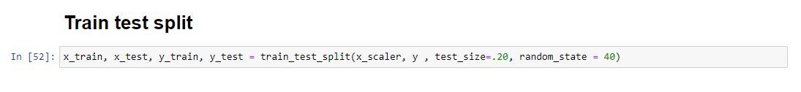
Train Test Split

Slide 15
Model Building
Linear Regression
Decision Tree Regressor
K-Neighbors Regressor
XGBoost Regressor
Random Forest Regressor
Gradient Boosting Regressor

Slide 16
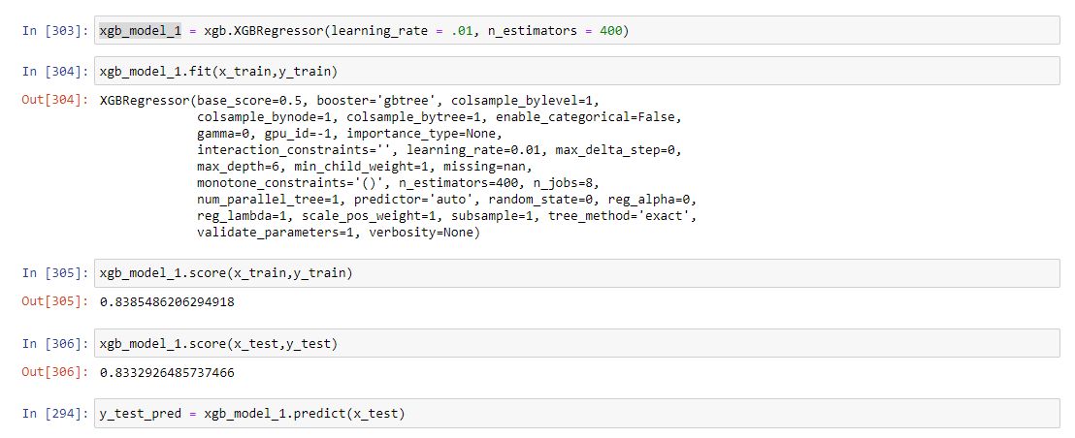
Accuracy Of Model

Slide 17
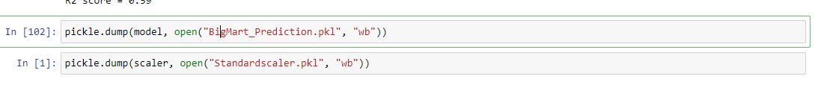
Model Saving

Slide 18
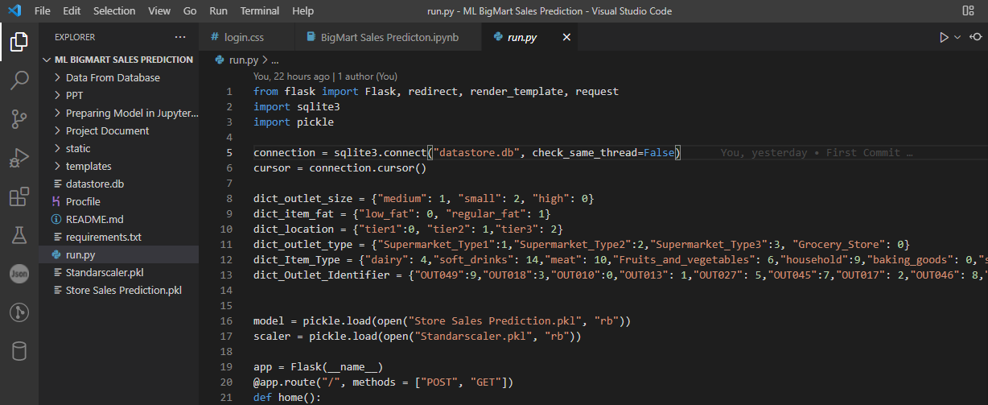
API Using Flask

Slide 19
Deployment:
The Cloud environment was set up and the project was deployed from GitHub into Heroku cloud platform.
App link- https://bigmartprediction147.herokuapp.com/

Slide 20
Thank You
Team Name :- Ex-Holkarian

